Slide 1



ML & Linear Regression
Nitin Tiwari
Google Developer Expert – Machine Learning Software Engineer @ LTIMindtree

Slide 2
$whoami
Software Engineer at LTIMindtree
Google Developer Expert in Machine Learning
Technical speaker; 30+ talks across India and South East Asia
Contributor to Google Dev Library
Love writing blogs on AI/ML

Slide 3
Content
What is Machine Learning?
Supervised Learning
Unsupervised Learning
Neural Networks
What is TensorFlow?
Interesting examples of Computer Vision
Gemini
Resources for you to get started

Slide 4

What is Machine Learning?
The ability of computers to learn without being explicitly programmed.
Explicitly programmed? What does that mean?
So, what happens in ML?
Data
Example:
Data = 2, 3
Rule = Addition
Answer = 5
Answers
Rules
Data
Example:
Data = 2, 3
Answer = 5
Rule = Addition
Rules
Answers

Slide 5


Supervised Learning
We ‘supervise’ the machine to learn by feeding it with both, the input data as well as label.
Once the machine has learned, we then feed it the data it hasn’t previously seen and expect it to predict/infer the correct label.
Example:
Apple 70%
Data
“Apple”
Unseen Data
Pears 30%
Label
Training a model
Evaluating a model

Slide 6
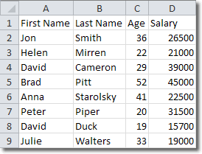

Types of Data
Data can mainly be classified into:
Structured Data
Unstructured Data
Structured Data – Data in the form of CSVs, JSON, Excel Sheets, databases, etc.
Unstructured Data – Data in the form of images, videos, emails, audio, social media posts, etc.

Slide 7
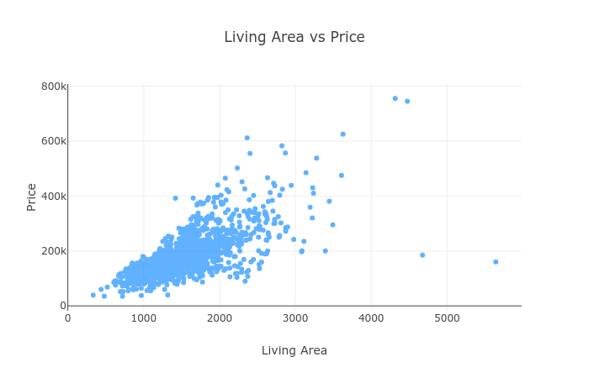
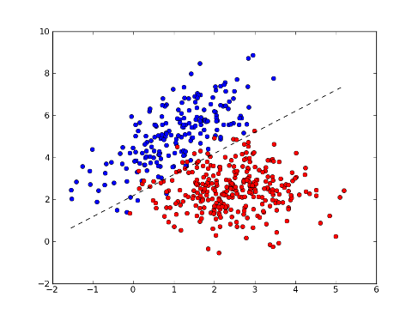
Supervised Learning on Structured Data
Supervised Learning on structured data mainly deals with –
Regression
Classification
Regression – Predict a value
Classification – Categorize into two or more classes

Slide 8

Supervised Learning on Unstructured Data
Computer Vision is a technique to solve ML problems when the data is in the form of images and videos.
Image Classification
Identify the content in the image
Output the most relevant class

Slide 9

Supervised Learning on Unstructured Data
Natural Language Processing is a technique to solve ML problems when the data format is textual or audio.
Examples:
Text-to-speech recognition (Google Search)
Speech-to-text (Digital voice assistants like Google Home, Alexa, Siri)
Email spam classifier (Gmail automatically classifies spam emails)
Hate speech recognition (YouTube comments, tweets on X, etc.)
Hello, please find the document.
You have w0n a l0tt€ry

Slide 10
R-squared
6
5
4
3
2
1
x | y | y - ȳ | (y - ȳ)²
1 | 2 | -2 | 4
2 | 4 | 0 | 0
3 | 5 | 1 | 1
4 | 4 | 0 | 0
5 | 5 | 1 | 1
Total |  |  | 6
Mean (ȳ)
0 1 2 3 4 5

Slide 11
R-squared
x | y | y - ȳ | (y - ȳ)² | ŷ | ŷ - ȳ | (ŷ - ȳ)²
1 | 2 | -2 | 4 | 2.8 | -1.2 | 1.44
2 | 4 | 0 | 0 | 3.4 | -0.6 | 0.36
3 | 5 | 1 | 1 | 4 | 0 | 0
4 | 4 | 0 | 0 | 4.6 | 0.6 | 0.36
5 | 5 | 1 | 1 | 5.2 | 1.2 | 1.44
Total |  |  | 6 |  |  | 3.6
6
5
4
3
2
1
Mean (ȳ)
R² = Σ(ŷ - ȳ)² / Σ(y - ȳ)²
= 3.6/6 = 0.6
0 1 2 3 4 5

Slide 12
Hands-on: Colab
Step 1: Clone the repository: https://github.com/NSTiwari/ML-GDSC
Step 2: Upload the notebook file on Google Colab.
Step 3: Execute the cells in the notebook by following the instructions.

Slide 13




Thank You.
medium.com/@tiwarinitin1999
twitter.com/@NSTiwari21
github.com/NSTiwari

